Slide 1
Internet programiranje
Tabele
mr. Amel TOROMAN, dipl.ing.el.

Slide 2
<html>...</html> deklaracija HTML dokumenta
<html xmlns="http://www.w3.org/1999/xhtml" lang="en">
<head>...</head> zaglavlje dokumenta
<meta http-equiv="Content-Type" content="text/html; charset=utf-8"> potrebno zbog prikaza naših slova
<?xml version="1.0" encoding="iso-8859-2"?>
<!DOCTYPE html PUBLIC "-//W3C//DTD XHTML 1.0 Transitional//EN" "http://www.w3.org/TR/xhtml1/DTD/xhtml1-transitional.dtd">
<title>...</title> naziv dokumenta; naslov stranice (nalazi se na vrhu prozora)
<body>...</body> tijelo dokumenta

Slide 3
Tabela
Elementi: redovi, kolone, polje (ćelija)
Sadržaj polja: tekst, slike, druge tabele,...
Tagovi:
  Tabela
<table> ... </table>
  Red
  <tr> ... </tr>
  Ćelija
<td> ... </td>
Kolona
Red
Ćelija

Slide 4
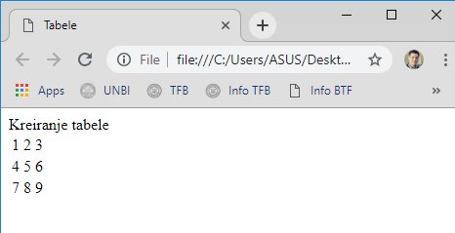
Kreiranje tabele
<html><head> Kreiranje tabele <title>Tabele</title>
</head><body>
<table>
<tr>
<td> 1 </td>
<td> 2 </td>
<td> 3 </td>
</tr>
<tr>
<td> 4 </td>
<td> 5 </td>
<td> 6 </td>
</tr>
<tr>
<td> 7 </td>
<td> 8 </td>
<td> 9 </td>
</tr>
</table>
</body></html>
tabela
polje

Slide 5
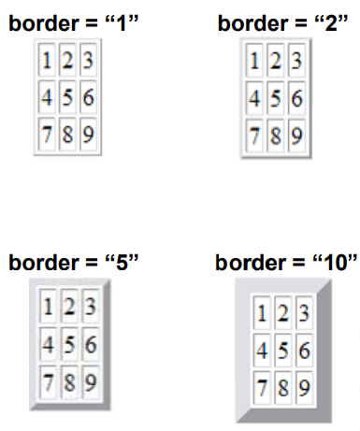
Okvir tabele atribut border taga table
<html<body>
<table border="2">
<tr>
<td> 1 </td>
<td> 2 </td>
<td> 3 </td>
</tr>
<tr>
<td> 4 </td>
<td> 5 </td>
<td> 6 </td>
</tr>
<tr>
<td> 7 </td>
<td> 8 </td>
<td> 9 </td>
</tr>
</table>
</body></html>

Slide 6
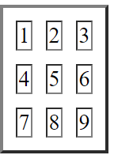
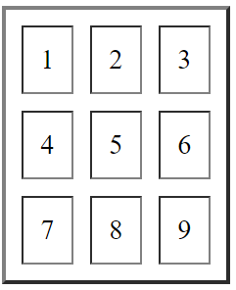
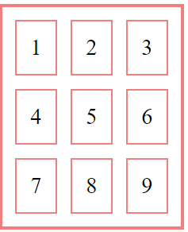
Razmak između ćelije i boja okvira
cellspacing - definiše debljinu graničnog prostora između ćelije
<table border="2“ cellspacing=“10”>
cellpadding - definiše razmak između okvira ćelije i sadržaja ćelije
<table border="2" cellspacing="10" cellpadding="10">
bordercolor - definiše boju okvira
<table border="2" cellspacing="10" cellpadding="10" bordercolor="#FO8080">

Slide 7
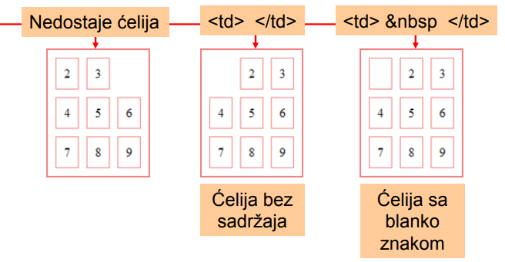
Prazna ćelija
<html><body>
<table border="2" cellspacing="10" cellpadding="10" bordercolor="#F08080">
<tr>
<td> 2 </td>
<td> 3 </td>
</tr>
<tr>
<td> 4 </td>
<td> 5 </td>
<td> 6 </td>
</tr>
<tr>
<td> 7 </td>
<td> 8 </td>
<td> 9 </td>
</tr>
</table>
</body></html>

Slide 8
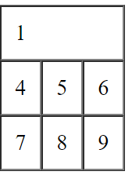
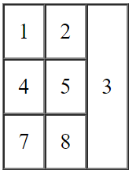
Spajanje ćelija (colspan i rowspan)
<table border="1" cellspacing="0" cellpadding="10">
<tr><td colspan="3"> 1 </td></tr>
<tr><td> 4 </td> <td> 5 </td> <td> 6 </td></tr>
<tr><td> 7 </td> <td> 8 </td> <td> 9 </td></tr>
</table>
<table border="1" cellspacing="0" cellpadding="10">
<tr><td> 1 </td> <td> 2 </td> <td rowspan="3"> 3 </td></tr>
<tr><td> 4 </td> <td> 5 </td> </tr>
<tr><td> 7 </td> <td> 8 </td></tr>
</table>

Slide 9
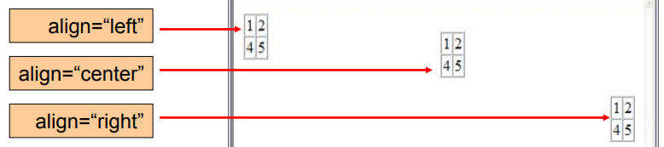
Centriranje tabele (atribut align u tagu table)
<table border="1" cellspacing="0" align="left">
<tr><td> 1 </td> <td> 2 </td> </tr>
<tr><td> 4 </td> <td> 5 </td> </tr>
</table>

Slide 10
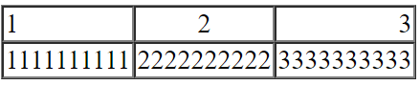
Horizontalno poravnanje sadržaja ćelije (atribut align u tagu td)
<table border="1" cellspacing="0" >
<tr><td align="left">1</td><td align="center">2</td><td align="right">3</td></tr>
<tr><td> 1111111111 </td> <td> 2222222222 </td> <td> 3333333333 </td> </tr>
</table>

Slide 11
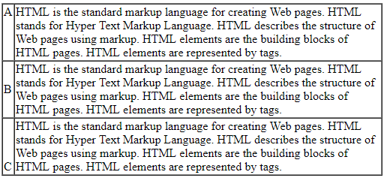
Vertikalno poravnanje sadržaja ćelije (atribut valign taga td)
<html><body>
<table border="1" cellspacing="0">
<tr>
<td valign="top"> A </td>
<td> ... </td>
</tr>
<tr>
<td valign="middle"> B</td>
<td> ... </td>
</tr>
<tr>
<td valign="bottom"> C </td>
<td> ... </td>
</tr>
</table>
</body></html>

Slide 12
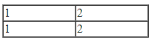
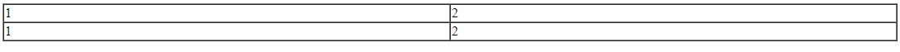
Dimenzionisanje tabele
Dužina tabele u pikselima - apsolutno dimenzionisanje
<html><body>
<table border="1" cellspacing="0" width="200">
<tr><td> 1 </td> <td> 2 </td></tr>
<tr><td> 1 </td> <td> 2 </td></tr>
</table>
</body></html>
Dužina tabele u procentima - relativno dimenzionisanje u odnosu na dužinu prozora
Tabela zauzima 80% dužine prozora. Dužina tabele prati promenu dužine prozora.
<html><body>
<table border="1" cellspacing="0" width="80%">
<tr><td> 1 </td> <td> 2 </td></tr>
<tr><td> 1 </td> <td> 2 </td></tr>
</table>
</body></html>

Slide 13
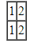
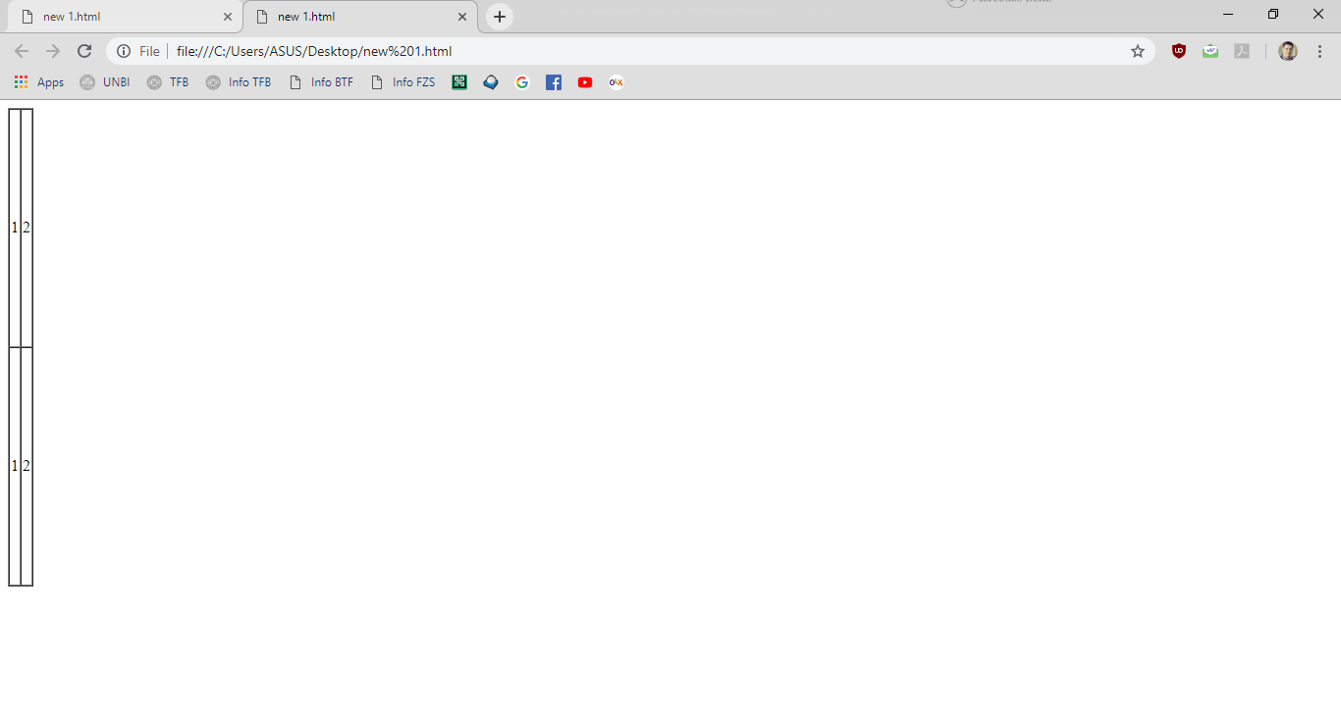
Dimenzionisanje tabele
Visina tabele u pikselima - fiksno
<table border="1" cellspacing="0" height="50">
<tr><td> 1 </td> <td> 2 </td></tr>
<tr><td> 1 </td> <td> 2 </td></tr>
</table>
Visina tabele u procentima - relativno u odnosu na visinu prozora
Tabela zauzima 80% dužine prozora. Dužina tabele prati promenu dužine prozora.
<table border="1" cellspacing="0" height=“80%">
<tr><td> 1 </td> <td> 2 </td></tr>
<tr><td> 1 </td> <td> 2 </td></tr>
</table>

Slide 14
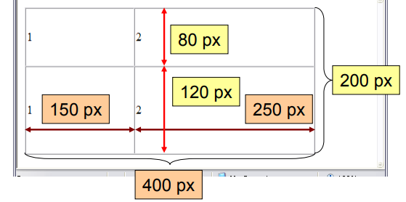
Dimenzionisanje ćelija (apsolutno)
Visina tabele u pikselima - fiksno
<table border="1" cellspacing="0" width="400" height="200">
<tr height="80"><td width="150"> 1 </td> <td width="250"> 2 </td></tr>
<tr height="120"><td> 1 </td> <td> 2 </td></tr>
</table>
400 = 150 + 250
200 = 80 + 120

Slide 15
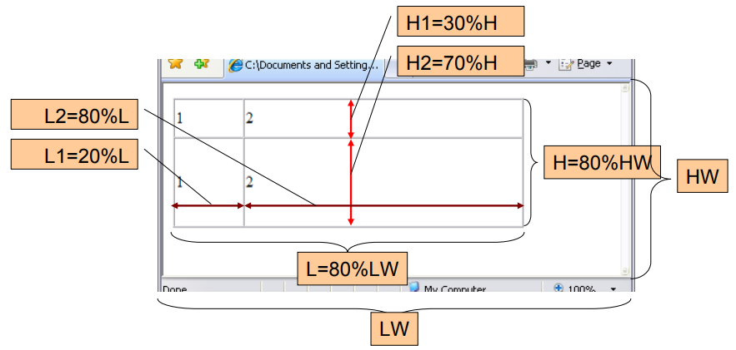
Dimenzionisanje ćelija (relativno)
<table border="1" cellspacing="0" width="80%" height="80%">
<tr height="30%"><td width="20%"> 1 </td> <td width="80%"> 2 </td></tr>
<tr height="70%"><td> 1 </td> <td> 2 </td></tr>
</table>

Slide 16
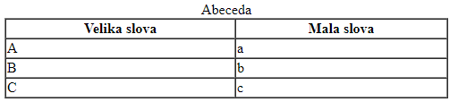
Naslovi
Naslov tabele:
<caption> … </caption>
Naslov kolone:
<th> … </th>
<table border="1" cellspacing="0" width="90%">
<caption> Abeceda </caption>
<th> Velika slova </th> <th> Mala slova </th>
<tr><td> A </td> <td> a </td></tr>
<tr><td> B </td> <td> b </td></tr>
<tr><td> C </td> <td> c </td></tr>
</table>

Slide 17
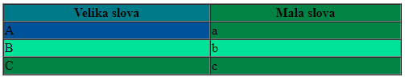
Boja pozadine
Atribut bgcolor:
Boja pozadine cijele tabele:
<table bgcolor=”#003399”>
Boja pozadine reda:
<tr bgcolor=”#003399”>
Boja pozadine ćelije:
<td bgcolor=”#003399”>
Boja pozadine naslova kolone:
<th bgcolor=”#003399”>
<table border="1" cellspacing="0" width="90%" bgcolor=”#883344”>
<th bgcolor=”#77AA88”> Velika slova </th> <th> Mala slova </th>
<tr><td bgcolor=”#553399”> A </td> <td> a </td></tr>
<tr bgcolor=”#EE3399”><td> B </td> <td> b </td></tr>
<tr><td> C </td> <td> c </td></tr>
</table>

Slide 18
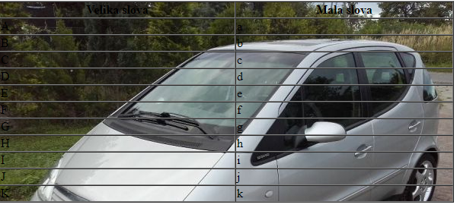
Slika kao pozadina
Atribut background:
Slika preko cijele tabele:
<table border="1" cellspacing="0" width="90%" background="sl.jpg">
<th> Velika slova </th> <th> Mala slova </th>
<tr><td> A </td> <td> a </td></tr>
<tr><td> B </td> <td> b </td></tr>
<tr><td> C </td> <td> c </td></tr>
<tr><td> D </td> <td> d </td></tr>
<tr><td> E </td> <td> e </td></tr>
<tr><td> F </td> <td> f </td></tr>
<tr><td> G </td> <td> g </td></tr>
<tr><td> H </td> <td> h </td></tr>
<tr><td> I </td> <td> i </td></tr>
<tr><td> J </td> <td> j </td></tr>
<tr><td> K </td> <td> k </td></tr>
</table>
<table background=”slika.gif”>
Slike kao pozadina reda:
<tr background=”slika.gif”>
Slika kao pozadina ćelije:
<td background=”slika.gif”>
Slik kao pozadina naslova kolone:
<th background=”slika.gif”>

Slide 19
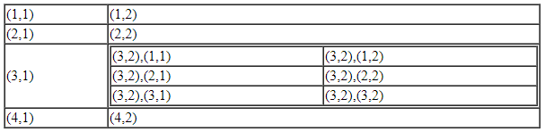
Ugnježdavanje tabela
Tabela unutar ćelije tabele
<table border="1" cellspacing="0" width="90%">
<tr><td> (1,1) </td> <td> (1,2) </td></tr>
<tr><td> (2,1) </td> <td> (2,2) </td></tr>
<tr><td> (3,1) </td>
<td>
<table border="1" cellspacing="0" width="100%">
<tr><td>(3,2),(1,1)</td><td>(3,2),(1,2)</td></tr>
<tr><td>(3,2),(2,1)</td><td>(3,2),(2,2)</td></tr>
<tr><td>(3,2),(3,1)</td><td>(3,2),(3,2)</td></tr>
</table>
</td></tr>
<tr><td> (4,1) </td> <td> (4,2) </td></tr>
</table>

Slide 20
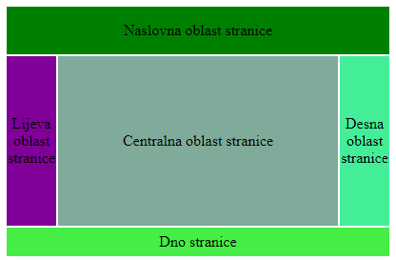
Definisanje lejauta stranice pomoću tabele
<table width="100%" height="100%">
<tr height="50"><td colspan="3" align="center" bgcolor="green">
Naslovna oblast stranice
</td> </tr>
<tr>
<td align="center" width="100" bgcolor="#800099">
Lijeva oblast stranice
</td>
<td align="center" width="80%" bgcolor="#80AA99">
Centralna oblast stranice
</td>
<td align="center" width="100" bgcolor="#44EE99">
Desna oblast stranice
</td>
</tr>
<tr height="30"><td colspan="3" align="center" bgcolor="#44EE44">
Dno stranice
</td> </tr>
</table>

